Slide 1
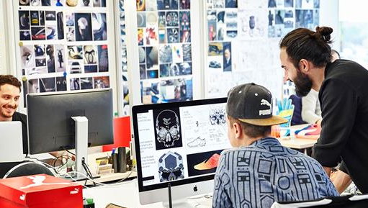
higher Design & Manufacture
The Design Team

Slide 2


Learning intentions & success criteria
Learning Intentions
I am developing an understanding of the design team and its members.
Success Criteria
Name the various experts who contribute to the design team.
Distinguish and explain between the different roles in the design team.

Slide 3



The design team
Products today have to compete in very wide market places and most commercially-produced items are mass produced.
They are usually the result of quite extensive developments in materials, systems technologies and production methods.
The more complex nature of modern products has made it impossible for any single designer to work on their own.
Most designers now work as part of bigger teams, liaising with other experts from time to time.
The diagram on the next slide gives an indication of the type of experts who may be asked to contribute to a design team.

Slide 4
DESIGN team members
Market Researcher
Sub-Contractor
Project Managers
Economist
Accountant
Retailer
Designer
Provides initial inspiration
Creative input
Controls product development
Engineer
Consumer
Manufacturer
Ergonomist
Lawyer
Materials Technologist
Marketing Team
Production Specialist

Slide 5

designer
Designers are responsible throughout the entire process.
They provide the initial inspiration, creative input and control product development.
They conduct research, sketch ideas, develop their ideas, produce a final design, and create multiple physical and virtual prototypes to test their design.
They are responsible for how the final product looks and functions.
Designers must collaborate with all the other design team members to ensure the product is successful and functions as expected.

Slide 6
Project Managers
The project manager is the individual responsible for delivering the project. The individual leads and manages the project team, with authority and responsibility from the project board, to run the project on a day-to-day basis.
Specifically they ensure all aspects of the project are completed on time, whilst planning activities and resources.
They also organise and motivate the project team, estimate cost and ensure the project is completed within. Finally, the monitor progress of the project

Slide 7

Market researcher
Market researchers will conduct various different forms of research, either looking at existing products, trends, gaps in the market to provide feedback on the needs and wants of consumers/target market.
They will also likely conduct various research techniques such as producing surveys and questionnaires.
Details of consumer views can include pricing, trends in buying and selling, and projected sales volume and demand.
They will also knowledge of competitors products.

Slide 8

accountant
Accountants are involved in the monetary matters in the project, by setting caps on spending, monitoring costs of each stage.
For example, they may be involved in setting the budget for the entire design and manufacturing process, allocating a specific budget to each stage in the process.
This ensures that the final product is economically viable and it will produce a profit for the company producing the product.
They also ensure that the product is costed at a price the public is willing to pay.

Slide 9

engineer
The engineers are responsible for figuring out how the final product will work. Depending on the product’s complexity, various different engineers may be required.
They will also work out the best and most efficient way for the product to go together, if it has multiple parts or if it requires the consumer to assemble it.
They are also concerned with the safety of a product to ensure it is not going to cause injury e.g. cuts or repetitive strain.

Slide 10
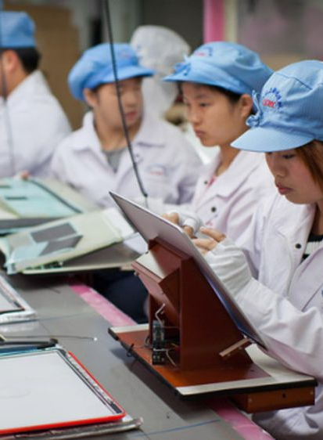
manufacturer
The manufacturers are the people that make the product. They also provide information on how the product could best be manufactured.
They can advice the company as to how products can be altered and allow it to be manufactured economically and efficiently.
Products today usually require various different forms of commercial manufacture. Large machines in factories produce components and assemble them. Some products will be assembled by hand or require some form of human input to produce the final product.

Slide 11

lawyer
Lawyers are involved in all the legalities of the design process.
They ensure legal aspects of the design, production, marketing and retailing of the product comply with current legislation.
They will also deal with patents and copyright issues.

Slide 12

Materials technologist
A materials technologist is a specialist on specific materials.
They will give advice on material properties best suited to the product e.g. strength, weight, flexibility, durability.
They will also advise on manufacturing methods, similarly with the manufacturers.
They will work closely with production specialists to ensure that any materials selected are suited to the methods of production available.

Slide 13

Production specialist
Production specialists provide information on all aspects of a product’s production.
They will try and find the most suitable rate of production considering economics, environmental concerns, materials, availability etc. Similarly, they provide plans for production tooling and planning ie. production rates, production volumes and select the most appropriate production system based on the projected number of units created for sale.
They will liaise with engineers and material technologists to ensure the product is produced as efficiently as possible.

Slide 14

Marketing team
The marketing team are responsible for promoting the product to consumers in as many ways as possible.
Traditionally, this is done through adverts on TV, posters and billboards, magazines etc.
Nowadays, advertising online is the most effective way of reaching most consumers, due to the abundance of smart phones, tablets, laptops and computers that consumers use.
Social media is a particularly powerful tool to advertise a new product.
They use market information to help publicise, with a focus on the 3Ps: Price, Promotion and Product

Slide 15

ergonomist
The ergonomists looks at the ergonomics (a design factors we will study later in more detail).
They are responsible for ensuring the product is comfortable to use and handle.
They are also responsible for ensuring that the product is easy to use, both in the way a person physically holds and interacts with it, as well as their understanding of how it works.
They will look at the aspects involved in ergonomics: anthropometrics, physiology and psychology.
They may also research and ensure the product ‘fits’ the specific target market e.g. age/sex.

Slide 16

consumer
Consumers are the people who buy and use the products. They are essentially the customers who need or want a specific product for a specific purpose.
They will likely have seen an advertisement of the product which compelled them to buy it or they were recommended it by a friend or company, based on their needs and wants.
Consumers can provide feedback to designers, marketing teams, researchers etc. on all aspects of the product.
Feedback is vital at all stages of development, therefore prototypes will often be tested by potential consumers.

Slide 17
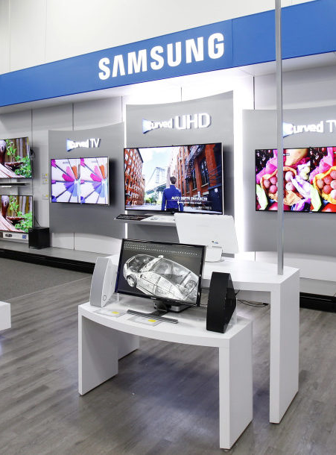
retailer
Retailers are the people who sell the products. They provide feedback on sales, whether a product is likely to sell or not, and have success insight based on their experiences of selling similar products.
You may find specific stores selling the one brand e.g. Apple, Microsoft, Dyson.
You may also find stores that sell various brands, e.g. PC World.
Today, Amazon is one of the largest online retailers, allowing consumers to purchase almost every product available for home delivery.

Slide 18

economist
Economists will look at the current economic climate before, during and after the product design and manufacture.
They can predict the strength of the economy when the product is likely to be manufactured and sold.
They will help determine when the best time to place a product on the market is, judging when the highest profits are likely to be made or when the greatest number of sales are likely to be made, e.g. Christmas is always a good time to release a new product due to the number of people shopping.

Slide 19

Sub-contractor
Sub-contractors provide expertise and services in a range of different fields.
They can also ensure the product is manufactured as efficiently as possible.
They are usually only required for specific times during the design process and can ensure additional confirmation of certain aspects such as those mentioned above.

Slide 20

Balancing roles
For products to be successful on the marketplace it is important that all of those involved in the design:
  Play their part
  Contribute effectively
Failing to do this will result in products that are unlikely to be successful

Slide 21

Balancing roles
The people who influence design can be split into three groups, based on the role they have to play in the design of products.
Creative Thinkers
Are involved in the development of the product from the initial concept through to the marketing strategy used to promote it
Technical Specialists
Are involved in aspects of the product’s material selection and manufacture
Business Specialists
Are concerned with the commercial, economic and marketing aspects of the product

